Slide 1
Exploratory Data Analysis (EDA) for First InteRn Project
Done by:Zeina Ahmed

Slide 2
Introduction
My goal is to understand the structure of the data, identify patterns, and extract meaningful insights. By analyzing this dataset, I aim to clean, preprocess, and visualize the data, ensuring it is ready for further analysis and decision-making.
EDA is a crucial step because it helps me:
Understand the dataset distribution and key characteristics.
Identify missing values, anomalies, and outliers.
Detect correlations between features.
Ensure data quality before proceeding with modeling or further analysis.

Slide 3
Dataset Overview
This dataset is an essential part of my project, and here is a breakdown of its structure:
Dataset Name: First Intern Project
Records (Rows): 36,285
Total Features (Columns): 17
Types of Features:
Numerical Features: 11
Categorical Features: 6
Text Features: ['Booking_ID', 'date of reservation']
Understanding the structure of the dataset allows me to determine the best techniques for handling data preprocessing, feature selection, and potential transformations.

Slide 4
Initial Observations
Missing Values: After analyzing the dataset, I found that there are no missing values.
Duplicates: The dataset does not contain any duplicate records.
Outliers: Using boxplots, I identified that some numerical features contain outliers. I handled them using the Interquartile Range (IQR) method to ensure that extreme values do not negatively impact the analysis.
Correlation Analysis: I applied a correlation matrix to the numerical columns, but I found that there is no significant correlation between them.
Visualizations: I created various plots, including histograms, countplots, and boxplots, to better understand the distribution and trends in the dataset.
By addressing these aspects, I ensured the dataset is clean and ready for visualization and further analysis.

Slide 5
Preprocessing Steps and Insights
During my preprocessing phase, I conducted several steps to clean and prepare the dataset:
Dataset Exploration:
Used head() and info() to get a quick overview of the dataset structure.
Checked the shape of the dataset to confirm the number of rows and columns.
Handling Missing Values and Duplicates:
Verified that there were no missing values, which ensured data completeness.
Checked for duplicate records and confirmed that there were none.

Slide 6
Preprocessing Steps and Insights
Data Types and Transformations:
Identified categorical, numerical, and text-based columns.
Ensured that categorical columns are properly formatted for future encoding.
Outlier Detection and Removal:
Used boxplots to detect outliers in numerical features.
Removed extreme values using the Interquartile Range (IQR) method to maintain data integrity

Slide 7
Visualizations
Visualization and Feature Understanding:
Generated histograms to analyze feature distributions.
Used countplots for categorical variable distributions.
Applied correlation matrices to check relationships between numerical features, confirming that there was no strong correlation.
Through these preprocessing steps, I ensured that the dataset was clean, structured, and ready for further analysis.

Slide 8
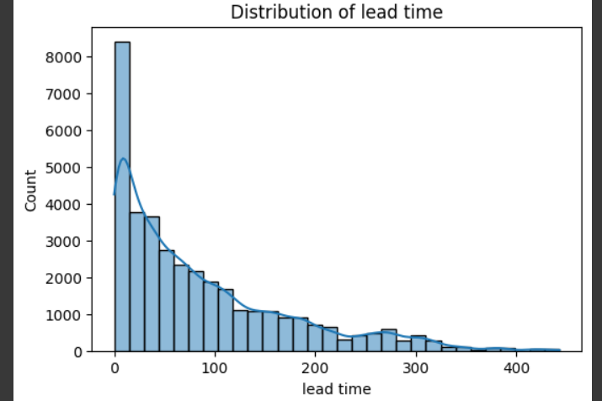
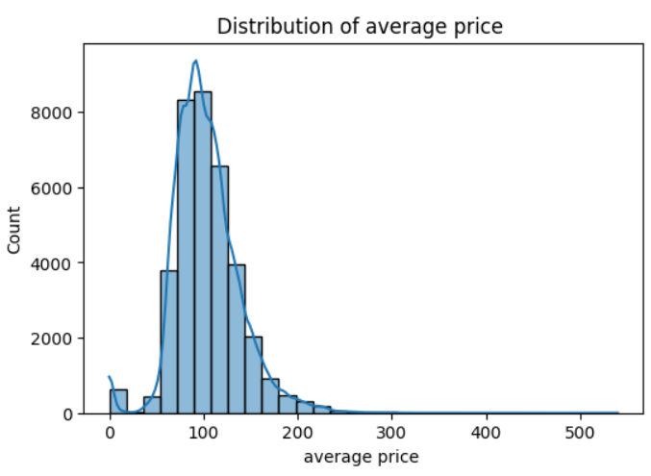
Visualizations

Slide 9
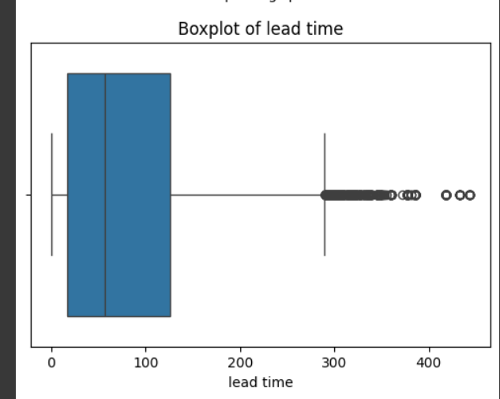
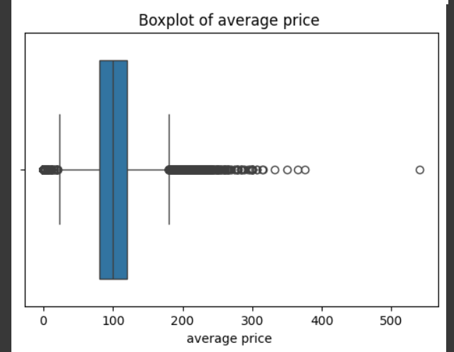
Visualizations
Before Removing outliers with IQR
We don’t need to remove outliers here because it is the price which is possible to have outliers

Slide 10
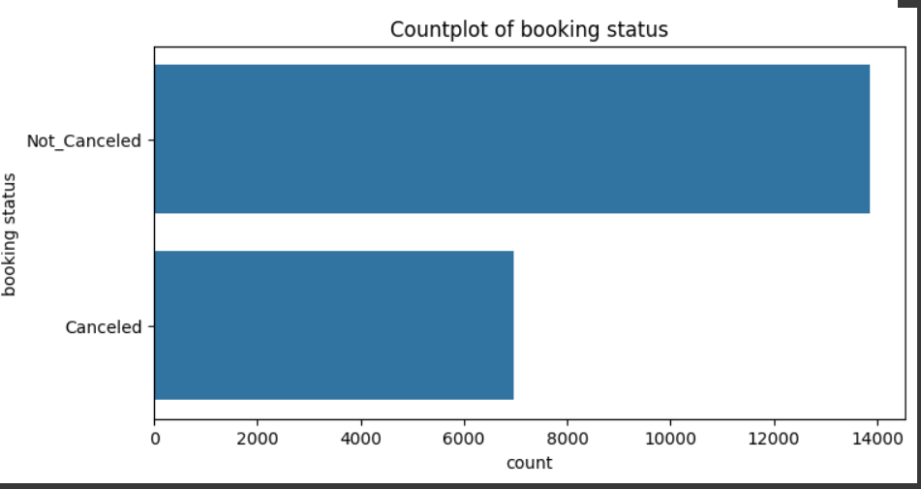
Visualizations
Count plot of the target column

Slide 11
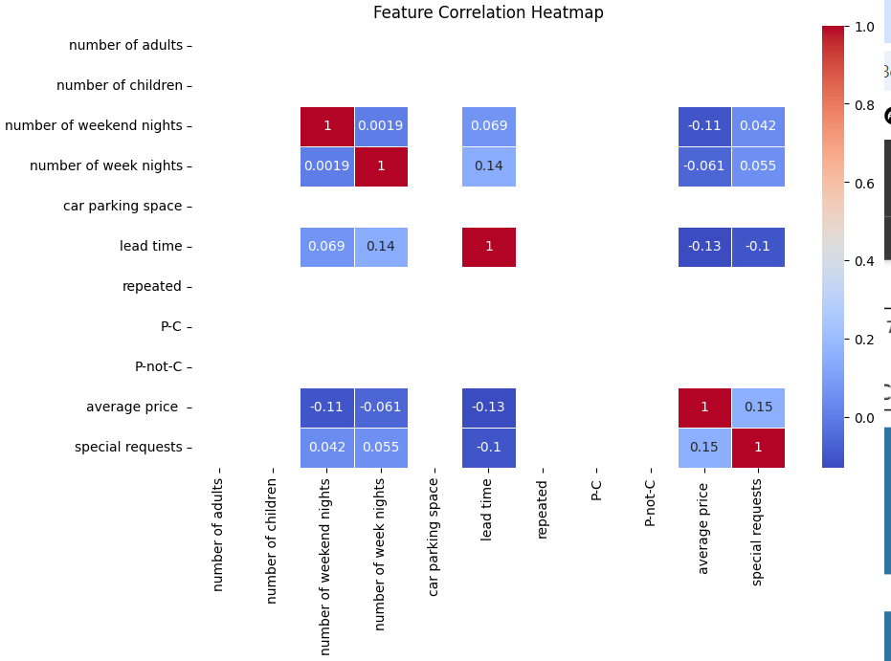
visualizations

Slide 12
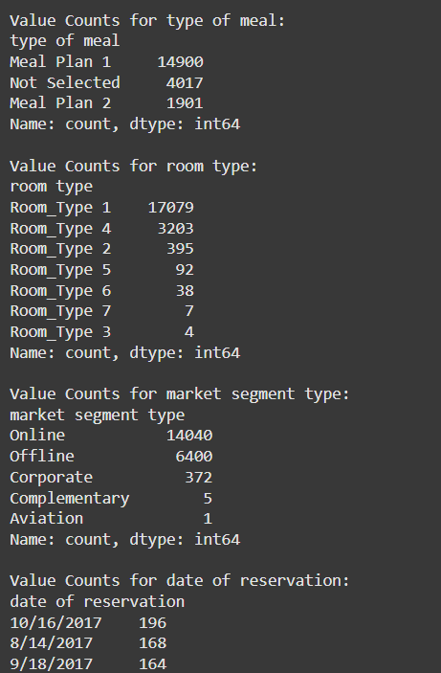
Visualizations

Slide 13
THANK YOU

